Slide 1
Machine Learning
Generated for: Autoencoders, Introduction, Architecture, Mathematical Formulation, Types of Autoencoders, Applications, Limitations
Notes:
Welcome to the Machine Learning presentation covering multiple topics. Today we'll explore: Autoencoders, Introduction, Architecture, Mathematical Formulation, Types of Autoencoders, Applications, Limitations.

Slide 2
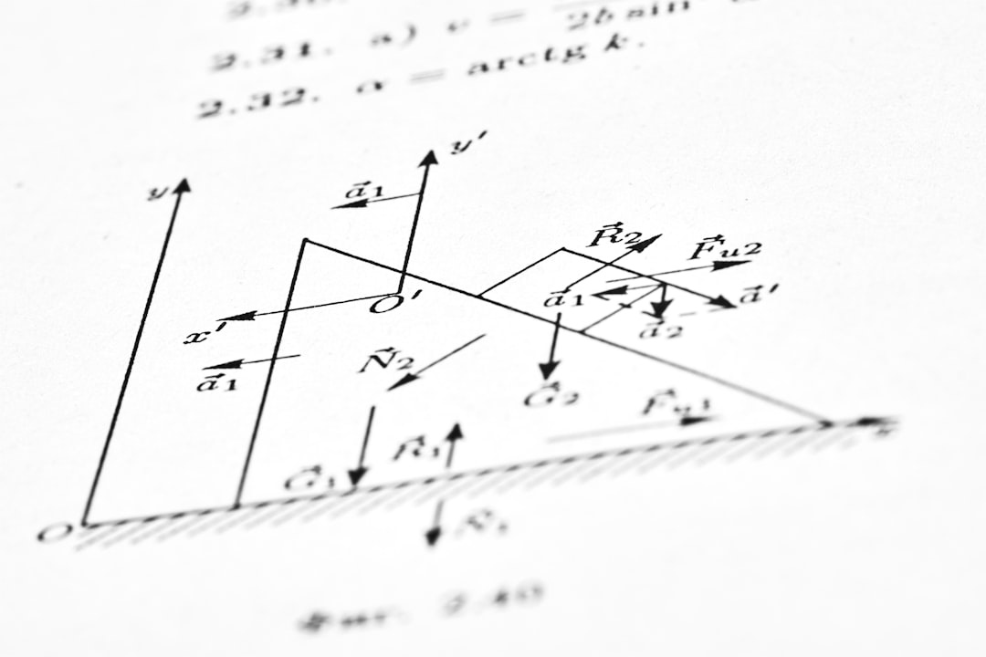
Autoencoders - Introduction
Autoencoders are neural networks for dimensionality reduction
Used for unsupervised learning and anomaly detection
Consist of encoder and decoder components
Encoder maps input to lower dimension
Decoder maps lower dimension back to input
Trained to minimize reconstruction error
Can learn compressed representations of data
Applicable to image and text data processing
Helps in noise reduction and feature learning
Notes:
When introducing autoencoders, explain their primary function as a dimensionality reduction tool and their application in unsupervised learning. Provide examples of how they can be used in image processing for noise reduction and in text data for feature extraction. Discuss the components of an autoencoder, including the encoder and decoder, and how they work together to minimize reconstruction error. Ask students to consider how autoencoders could be applied to real-world problems, such as data compression or anomaly detection. Key takeaways should include understanding the basic architecture and the potential applications of autoencoders in machine learning.

Slide 3
Autoencoders - Introduction
Autoencoders are neural networks for dimensionality reduction
Comprise encoder and decoder components
Encoder maps input to lower dimension
Decoder maps lower dimension back to input
Trained to minimize reconstruction error
Used for anomaly detection and generative models
Can be used for image and text data compression
Autoencoders are unsupervised learning models
Helps in feature learning and extraction
Improves performance of other machine learning models
Notes:
When introducing autoencoders, explain that they are a type of neural network used for dimensionality reduction, which is the process of reducing the number of features or dimensions in a dataset while preserving the most important information. Provide examples of how autoencoders can be used in real-world applications such as image compression, anomaly detection, and generative models. Ask students to consider the benefits of using autoencoders, such as improved performance of other machine learning models and the ability to extract meaningful features from data. Key takeaways include understanding the components of an autoencoder, including the encoder and decoder, and how they work together to minimize reconstruction error.

Slide 4
Autoencoders - Architecture
Autoencoders consist of encoder and decoder networks
Encoder maps input to lower-dimensional latent space
Decoder maps latent space back to original input space
Training involves minimizing reconstruction error
Commonly used loss function is mean squared error
Architecture can be customized for specific tasks
Convolutional autoencoders use convolutional layers
Recurrent autoencoders use recurrent neural networks
Autoencoders can be used for dimensionality reduction
Example: image compression using autoencoders
Notes:
When explaining the architecture of autoencoders, emphasize the role of the encoder and decoder networks. Provide examples of how autoencoders can be customized for specific tasks, such as image compression or anomaly detection. Ask students to consider how the choice of loss function and architecture can impact the performance of the autoencoder. Key takeaways include understanding the basic components of an autoencoder and how they can be applied to real-world problems.

Slide 5
Introduction - Overview of Machine Learning
Machine learning is a subset of artificial intelligence
Enables systems to learn from data without programming
Improves performance on tasks over time
Applications in image recognition and natural language
Used in recommendation systems and predictive analytics
Supervised and unsupervised learning techniques exist
Reinforcement learning is a subfield of machine learning
Real-world examples include self-driving cars and chatbots
Machine learning drives business intelligence and decision-making
Notes:
When introducing machine learning, emphasize its role as a subset of artificial intelligence that allows systems to learn from data. Provide examples of applications such as image recognition, natural language processing, and recommendation systems. Explain the difference between supervised, unsupervised, and reinforcement learning. Use real-world examples like self-driving cars and chatbots to illustrate the impact of machine learning. Ask students to consider how machine learning can be applied in various industries and what ethical considerations arise from its use. Key takeaways should include understanding machine learning's potential and its growing importance in business intelligence and decision-making.

Slide 6
Introduction - Introduction
Machine learning is a subset of artificial intelligence.
Involves training algorithms on data to make predictions.
Enables computers to learn from experience.
Improves performance on tasks without explicit programming.
Applies to image recognition, speech recognition, and more.
Used in self-driving cars, medical diagnosis, and finance.
Can be supervised, unsupervised, or reinforcement learning.
Requires large datasets and computational resources.
Has many real-world applications and growing demand.
Impacts various industries and aspects of daily life.
Notes:
When introducing machine learning, emphasize its connection to artificial intelligence and its ability to learn from data. Provide examples of applications such as image recognition and self-driving cars to illustrate its impact. Discuss the different types of machine learning, including supervised, unsupervised, and reinforcement learning. Ask students about potential applications in their own fields of interest and how machine learning could solve real-world problems. Key takeaways should include understanding the basics of machine learning and its vast potential for innovation and improvement in various industries.

Slide 7
Introduction - Definition and Overview
Machine learning is a subset of artificial intelligence
Enables systems to learn from data without programming
Involves statistical models and algorithms
Used in image recognition and natural language processing
Applies to predictive maintenance and quality control
Includes supervised, unsupervised, and reinforcement learning
Improves performance with experience and data
Requires large datasets for training and testing
Has applications in healthcare, finance, and transportation
Notes:
When introducing machine learning, emphasize its role as a subset of AI, focusing on learning from data. Provide examples such as image recognition in self-driving cars and natural language processing in virtual assistants. Explain that machine learning involves statistical models and algorithms, and highlight its applications across various industries. Ask students to consider how machine learning can be applied to real-world problems they're interested in, and how it differs from traditional programming. Key takeaways should include the definition of machine learning, its types, and its broad range of applications.

Slide 8
Architecture - Introduction
Machine learning integrates with architecture for predictive modeling
Neural networks enable complex pattern recognition in buildings
Deep learning applies to architectural design and optimization
Convolutional neural networks analyze building images and structures
Recurrent neural networks predict energy consumption patterns
Architecture informatics combines ML and design principles
Generative models create novel architectural designs and layouts
ML algorithms improve building management and maintenance systems
Data-driven approaches enhance urban planning and development
y = f(x) equation applies to ML-based architectural modeling
Notes:
When introducing the topic of machine learning in architecture, emphasize the potential of predictive modeling and pattern recognition in building design. Provide examples of how neural networks can analyze and optimize architectural structures, and discuss the role of deep learning in energy consumption prediction. Ask students to consider how ML can improve building management and maintenance, and what implications this has for urban planning and development. Key takeaways include the integration of ML and architecture, and the application of data-driven approaches to design and optimization.

Slide 9
Architecture - Machine Learning Fundamentals
Machine learning integrates with architecture for predictive modeling
Neural networks apply to building design and optimization
Deep learning enhances architectural visualization techniques
Convolutional neural networks for image recognition in architecture
Recurrent neural networks for sequential data in building design
Y = sigmoid(X) equation applies to neural network activation
Generative models create new building designs and layouts
Computer vision analyzes and improves architectural designs
Natural language processing for architectural text analysis
Machine learning algorithms improve building energy efficiency
Notes:
When teaching this topic, emphasize the role of machine learning in revolutionizing architectural design and optimization. Provide examples of how neural networks and deep learning can be applied to predict building performance, enhance visualization, and automate design tasks. Ask students to consider the potential benefits and limitations of integrating machine learning with architecture, and encourage them to explore case studies of successful implementations. Key takeaways should include the various machine learning techniques and their applications in architecture, as well as the importance of interdisciplinary collaboration between architects, engineers, and data scientists.

Slide 10
Architecture - Machine Learning Basics
Machine learning integrates with architecture for predictive modeling
Neural networks used for image classification in architecture
Deep learning for object detection in building designs
Convolutional neural networks for architectural style analysis
Recurrent neural networks for sequential data in architecture
Autoencoders for dimensionality reduction in building models
Generative models for generating new building designs
y = wx + b equation used in linear regression models
Architecture informatics combines ML and architecture principles
Applications in urban planning and sustainable design
Notes:
When teaching this slide, explain how machine learning is integrated into architecture to enhance predictive modeling and design. Provide examples of neural networks used in image classification and deep learning for object detection. Discuss the applications of convolutional neural networks in architectural style analysis and recurrent neural networks in sequential data. Use the equation y = wx + b to illustrate simple linear regression models. Ask students to consider how generative models can be used to create new building designs and how architecture informatics combines machine learning and architecture principles. Key takeaways include understanding the role of machine learning in architecture and its potential applications in urban planning and sustainable design.

Slide 11
Mathematical Formulation - Introduction
Machine learning relies on mathematical models
Linear algebra is fundamental to ML
Probability theory is crucial for predictions
Calculus optimizes model parameters
Statistics helps in data analysis and visualization
Mathematical formulation is key to ML algorithms
Vector spaces represent data in ML
Matrices and tensors are used extensively
Equation: y = wx + b, simple linear model
Formulation affects model performance and accuracy
Notes:
When introducing mathematical formulation in machine learning, emphasize the importance of linear algebra, probability, and calculus. Explain how these mathematical concepts are used to develop and optimize machine learning models. Use simple examples like linear regression (y = wx + b) to illustrate the concept. Ask students to think about how different mathematical formulations can impact model performance and accuracy. Key takeaways should include understanding the role of mathematical models in machine learning and recognizing the significance of proper formulation for effective model development.

Slide 12
Mathematical Formulation - Introduction
Machine learning relies on mathematical models
Linear algebra is fundamental to ML
Probability theory underlies many algorithms
Optimization techniques are crucial for training
Statistical learning theory provides framework
Mathematical formulation enables model interpretation
Vector spaces are used for data representation
Matrix operations are essential for computations
Calculus is used for gradient descent optimization
y = wx + b is a simple linear equation example
Notes:
When introducing the mathematical formulation of machine learning, emphasize the importance of linear algebra, probability theory, and optimization techniques. Provide examples of how these concepts are applied in real-world ML applications. Ask students to consider how mathematical models can be used to interpret and improve ML models. Discuss the role of statistical learning theory in providing a framework for machine learning. Use the simple linear equation y = wx + b as an example to illustrate the concept of mathematical formulation in ML. Encourage students to think about the mathematical foundations of ML and how they can be used to build more effective models.

Slide 13
Mathematical Formulation - Foundations
Linear Regression uses ordinary least squares method
Logistic Regression applies sigmoid function for classification
Decision Trees utilize entropy for splitting criteria
Random Forests combine multiple decision trees
Support Vector Machines use kernels for complex data
Neural Networks employ backpropagation for training
Gradient Descent optimizes model parameters
Regularization techniques prevent overfitting
Cross-validation evaluates model performance
y = wx + b represents simple linear equation
Notes:
When discussing mathematical formulation foundations, emphasize the importance of understanding the underlying algorithms. Provide examples of linear and logistic regression, and explain how decision trees and random forests work. Use the equation y = wx + b to illustrate a simple linear model. Ask students to consider the role of regularization and cross-validation in preventing overfitting and evaluating model performance. Key takeaways include understanding the mathematical basis of machine learning algorithms and recognizing the importance of model evaluation and optimization.

Slide 14
Types of Autoencoders - Introduction
Autoencoders are neural networks for dimensionality reduction
Used for anomaly detection and generative modeling tasks
Consist of encoder and decoder components
Encoder maps input to lower-dimensional representation
Decoder maps representation back to original input
Variants include sparse, denoising, and contractive autoencoders
Applications in image and text processing tasks
Can be used for feature learning and data compression
Helpful in reducing noise in datasets and improving models
Notes:
When introducing the types of autoencoders, explain that autoencoders are a type of neural network that can be used for dimensionality reduction, anomaly detection, and generative modeling. Provide examples of how autoencoders can be used in image and text processing tasks, such as image compression and text summarization. Emphasize the importance of the encoder and decoder components and how they work together to learn a compact representation of the input data. Ask students to consider the potential applications of autoencoders in their own research or projects, and how they can be used to improve the performance of other machine learning models. Key takeaways include understanding the basic architecture of an autoencoder and the different variants that exist, such as sparse and denoising autoencoders.

Slide 15
Types of Autoencoders - Variants
Simple Autoencoders for dimensionality reduction
Sparse Autoencoders for feature learning
Convolutional Autoencoders for image data
Recurrent Autoencoders for sequential data
Denoising Autoencoders for robustness
Contractive Autoencoders for disentangled features
Variational Autoencoders for generative models
Adversarial Autoencoders for domain adaptation
Stacked Autoencoders for deep representations
Notes:
When discussing the variants of autoencoders, emphasize their applications and strengths. For instance, Simple Autoencoders are useful for dimensionality reduction, while Convolutional Autoencoders are more suitable for image data. Ask students to consider the type of data they are working with and which autoencoder variant would be most appropriate. Key takeaways include understanding the differences between autoencoder variants and their applications in machine learning tasks.

Slide 16
Types of Autoencoders - Variants
Simple Autoencoders for dimensionality reduction
Sparse Autoencoders for feature learning
Denoising Autoencoders for robustness
Contractive Autoencoders for disentangled features
Variational Autoencoders for generative models
Convolutional Autoencoders for image data
Recurrent Autoencoders for sequential data
Adversarial Autoencoders for robust representations
Stacked Autoencoders for hierarchical features
Notes:
When discussing the variants of autoencoders, emphasize their applications and strengths. For instance, highlight how sparse autoencoders can be used for feature learning and how variational autoencoders can be used for generative modeling. Provide examples of each type, such as using convolutional autoencoders for image compression and recurrent autoencoders for text data. Ask students to consider the trade-offs between different variants and how they can be combined for more complex tasks. Key takeaways include understanding the different architectures and their use cases, as well as the importance of selecting the right variant for a specific problem.

Slide 17
Applications - Introduction
Machine learning applies to image recognition systems
Natural language processing for chatbots and assistants
Predictive analytics for business decision making
Recommendation systems for e-commerce websites
Speech recognition for voice-controlled devices
Medical diagnosis with machine learning algorithms
Time series forecasting for stock market analysis
Anomaly detection for cybersecurity threats
Autonomous vehicles using machine learning models
Notes:
When introducing applications of machine learning, emphasize the breadth of areas where machine learning is used, from image recognition to natural language processing and predictive analytics. Provide examples such as how Netflix uses recommendation systems to suggest movies. Ask students to think about how machine learning impacts their daily lives and what other potential applications they can envision. Key takeaways should include understanding the variety of machine learning applications and how these technologies are transforming industries.

Slide 18
Applications - Machine Learning Variants
Natural Language Processing for text analysis
Computer Vision for image recognition systems
Predictive Maintenance in industrial automation
Recommendation Systems for e-commerce platforms
Speech Recognition for voice assistants
Time Series Forecasting for financial markets
Anomaly Detection for cybersecurity threats
Clustering for customer segmentation analysis
Regression for continuous data prediction models
Notes:
Explain the various applications of machine learning, providing concrete examples such as Siri for speech recognition and Netflix for recommendation systems. Discuss the role of machine learning in predictive maintenance and anomaly detection. Ask students to consider real-world scenarios where machine learning can be applied, and what benefits it can bring to industries. Emphasize the importance of understanding the different variants of machine learning and their applications in solving complex problems.

Slide 19
Applications - Real-World Implementations
Predictive maintenance in manufacturing industries
Image recognition in healthcare for disease diagnosis
Natural language processing in customer service chatbots
Recommendation systems in e-commerce platforms
Speech recognition in virtual assistants like Siri
Time series forecasting in financial markets analysis
Anomaly detection in cybersecurity threat identification
Sentiment analysis in social media monitoring tools
Clustering in market segmentation and targeting
Notes:
When discussing real-world implementations of machine learning, highlight the diversity of applications across industries. Explain how predictive maintenance can reduce downtime in manufacturing, and how image recognition aids in medical diagnosis. Use examples like Netflix's recommendation system to illustrate the impact on consumer behavior. Ask students to consider the ethical implications of machine learning in areas like surveillance and data privacy, and how these technologies can be used responsibly. Key takeaways should include the broad applicability of machine learning and its potential to drive innovation and efficiency in various sectors.

Slide 20
Limitations - Introduction
Machine learning models have limited interpretability
Lack of transparency in decision-making processes
Insufficient training data affects model accuracy
Overfitting occurs when models are too complex
Underfitting happens with overly simplistic models
Biased data leads to unfair model outcomes
Model drift occurs when data distributions change
Limited explainability in deep learning models
Adversarial attacks can manipulate model outputs
Data quality issues impact model performance greatly
Notes:
When introducing limitations of machine learning, emphasize the importance of understanding these constraints to improve model performance and fairness. Discuss how lack of interpretability and transparency can lead to mistrust in AI systems. Provide examples of how insufficient training data or biased data can affect model accuracy and fairness. Ask students to consider real-world scenarios where these limitations might be particularly problematic, such as in healthcare or finance, and how they might address these challenges in their own projects. Key takeaways include recognizing the potential pitfalls in machine learning development and the need for ongoing model evaluation and refinement.

Slide 21
Limitations - Introduction to Machine Learning Constraints
Machine learning models are prone to overfitting and underfitting issues
Data quality and availability significantly impact model performance
Limited interpretability of complex neural network architectures
High computational costs for large-scale data processing
Requires significant expertise in programming and statistics
Vulnerability to adversarial attacks and data poisoning
Explainability and transparency are major concerns
Lack of standardization in model evaluation metrics
Dependence on high-quality training data and labeling
Scalability issues with increasing data and model complexity
Notes:
When introducing the limitations of machine learning, emphasize the importance of understanding these constraints to effectively apply and improve machine learning models. Discuss how overfitting and underfitting can be addressed through techniques like regularization and cross-validation. Provide examples of how data quality and availability can significantly impact model performance, such as in medical diagnosis or financial forecasting. Ask students to consider the ethical implications of limited interpretability and vulnerability to adversarial attacks. Key takeaways should include the need for careful model selection, data preprocessing, and ongoing evaluation to mitigate these limitations.

Slide 22
Limitations - Introduction to Challenges
Machine learning models require large datasets for training
Insufficient data leads to poor model performance and accuracy
Overfitting occurs when models are too complex for data
Underfitting happens when models are too simple for data
Bias and variance issues affect model generalization
Noise and missing data impact model reliability
High-dimensional data poses computational challenges
Interpretability of models is often difficult to achieve
Explainability of results is crucial for model trustworthiness
Notes:
When discussing the limitations of machine learning, emphasize the importance of data quality and quantity. Explain how overfitting and underfitting can occur, and provide examples of how these issues can be addressed. Ask students to consider the challenges of working with noisy or missing data, and how these challenges can be overcome. Key takeaways include the need for careful model selection and validation, as well as the importance of considering the limitations of machine learning models in real-world applications.

